Slide 1

A+ Guide to Hardware, 9th Edition
Chapter 3
All About Motherboards
Notes:
1
A+ Guide to Hardware, 9th Edition
Chapter 3
All About Motherboards

Slide 2
Objectives
Describe and contrast various types and features of motherboards
Configure a motherboard using BIOS or UEFI firmware
Maintain a motherboard, including updating drivers, flashing UEFI/BIOS, and replacing the CMOS battery
Select, install, and replace a motherboard
Notes:
Objectives
Describe and contrast various types and features of motherboards
Configure a motherboard using BIOS or UEFI firmware
Maintain a motherboard, including updating drivers, flashing UEFI/BIOS, and replacing the CMOS battery
Select, install, and replace a motherboard

Slide 3
Motherboard Types and Features
Motherboard
Most complicated computer component
One of the first items to consider when building a computer
Consider the following when purchasing a motherboard:
Form factor
Processor socket and chipset
Buses and number of bus slots
Other connectors, slots, and ports
Notes:
Motherboard Types and Features
Motherboard
Most complicated computer component
One of the first items to consider when building a computer
Consider the following when purchasing a motherboard:
Form factor
Processor socket and chipset
Buses and number of bus slots
Other connectors, slots, and ports

Slide 4
Motherboard Form Factors
Determines motherboard size, features
Compatible with power supplies, cases, processors, expansion cards
Most popular
ATX, MicroATX, and Mini-ITX(scarce)
Mini-ITX is smaller than MicroATX and is also known as ITX
The following slides show examples of form factors and comparisons of sizes and hold positions of several form factors
Notes:
Motherboard Form Factors
Determines motherboard size, features
Compatible with power supplies, cases, processors, expansion cards
Most popular
ATX, MicroATX, and Mini-ITX
Mini-ITX is smaller than MicroATX and is also known as ITX
The following slides show examples of form factors and comparisons of sizes and hold positions of several form factors

Slide 5
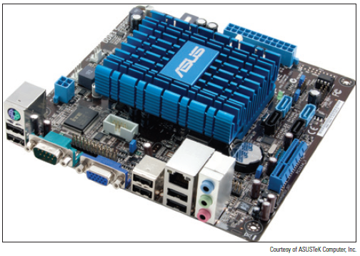
Motherboard Form Factors
Figure 3-3 A Mini-ITX motherboard
Notes:
Motherboard Form Factors

Slide 6
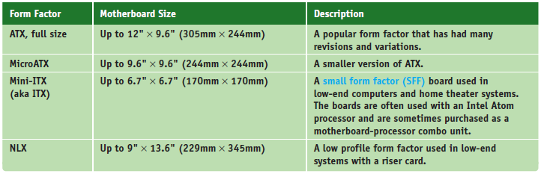
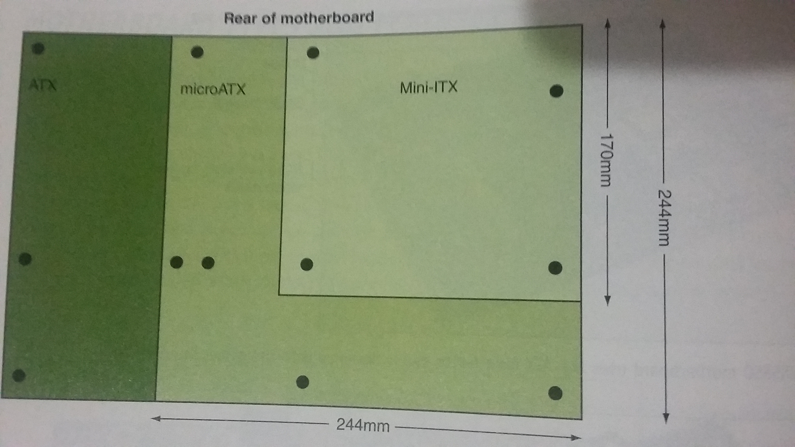
Motherboard Form Factors
Table 3-1 Motherboard form factors
Notes:
Motherboard Form Factors

Slide 7
Processor Sockets
Processor socket – determines which processors a board can support
Socket holds Intel or AMD processors
Sockets for Intel processors
Intel makes several type of processors
Notes:
Processor Sockets
Processor socket – determines which processors a board can support
Socket holds Intel or AMD processors
Sockets for Intel processors
Intel makes several Itanium and Xeon processors designed for servers

Slide 8
Processor Sockets
These processors and their corresponding sockets use different methods to make contacts between them:
Pin grid array (PGA) socket
Pins aligned in uniform rows around socket
Land grid array (LGA)
Uses lands (pads) rather than pins
Examples of LGA sockets: LGA775 and LGA1366
Flip-chip land grid array (FCLGA) socket
Chip is flipped over so that the top of the chip is on the bottom and makes contact with the socket
Notes:
Processor Sockets
Sockets and processor use different methods to make contacts between them:
Pin grid array (PGA) socket
Pins aligned in uniform rows around socket
Land grid array (LGA)
Uses lands (pads) rather than pins
Examples of LGA sockets: LGA775 and LGA1366
Flip-chip land grid array (FCLGA) socket
Chip is flipped over so that the top of the chip is on the bottom and makes contact with the socket

Slide 9
Processor Sockets
Sockets and processor use different methods to make contacts between them (cont’d):
Staggered pin grid array (SPGA)
Pins staggered over socket
Squeezes more pins into a small space
Ball grid array (BGA)
Not really a socket
Processor is soldered to the motherboard
Notes:
Processor Sockets
Sockets and processor use different methods to make contacts between them (cont’d):
Staggered pin grid array (SPGA)
Pins staggered over socket
Squeezes more pins into a small space
Ball grid array (BGA)
Not really a socket
Processor is soldered to the motherboard

Slide 10
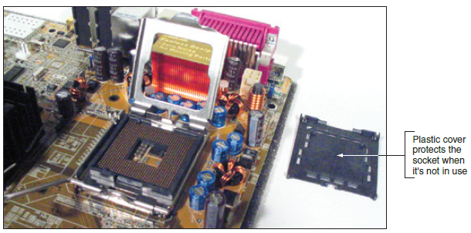
Processor Sockets
Figure 3-7 Socket LGA775 is the first Intel socket to use lands rather than pins
Notes:
Processor Sockets

Slide 11
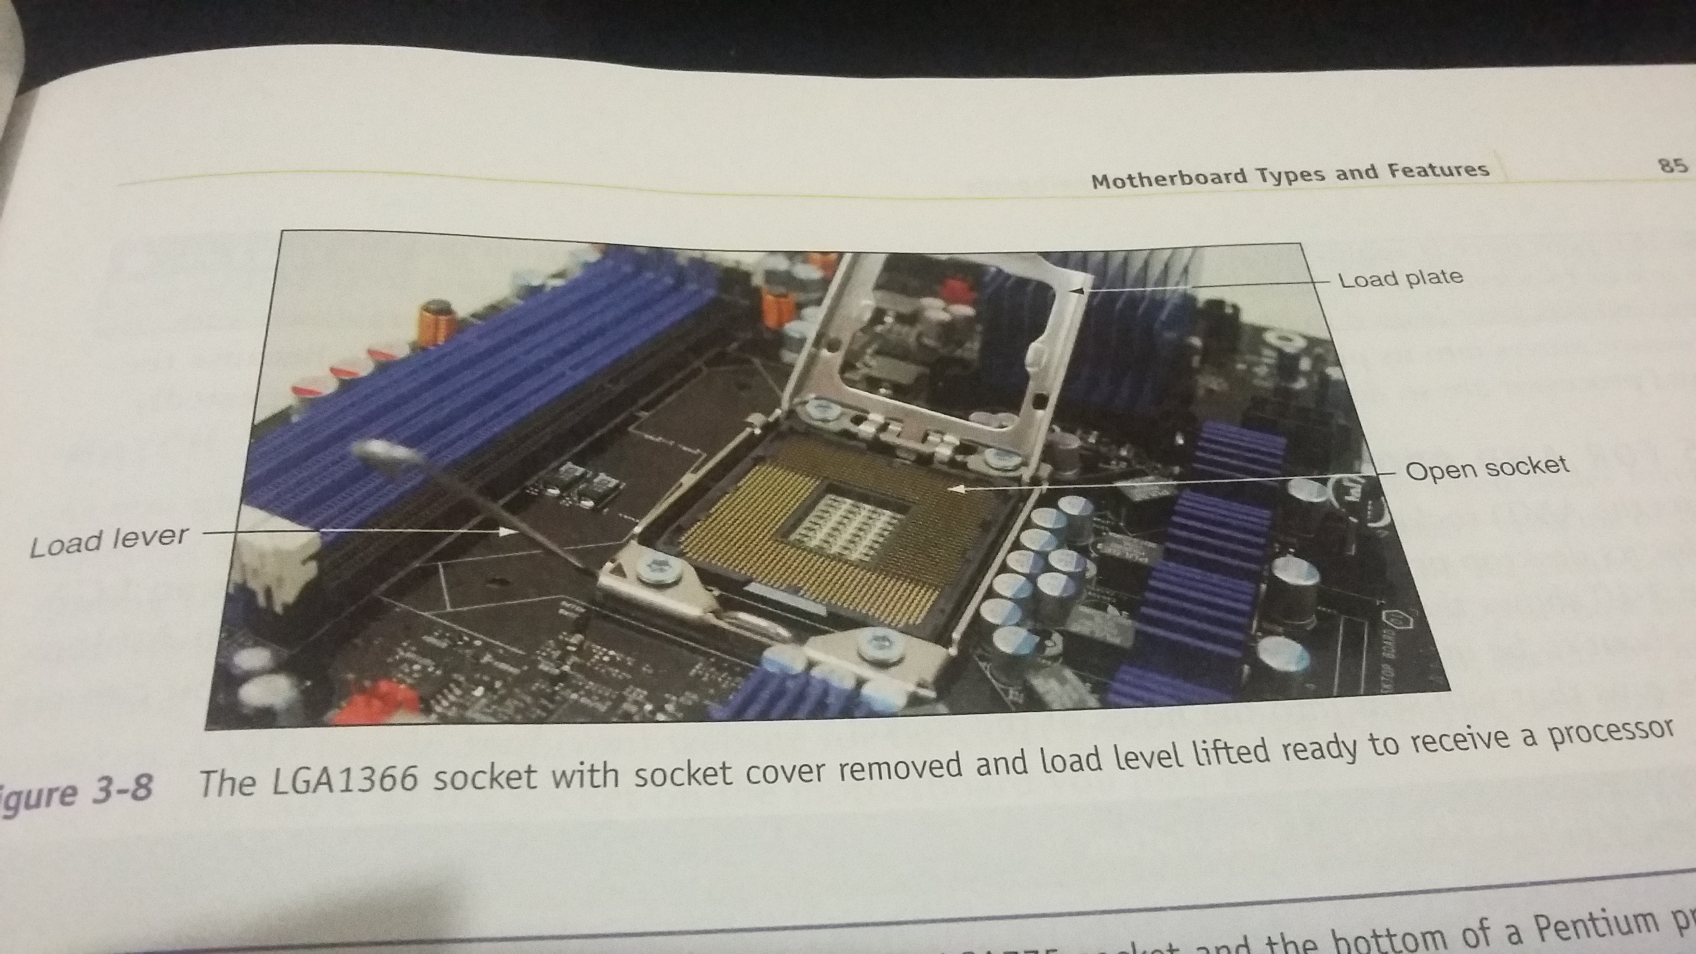
Processor Sockets
Notes:
Processor Sockets

Slide 12
Processor Sockets
Zero insertion force (ZIF) sockets
All current processor sockets
Side lever lifts processor up and out of the socket
Sockets for AMD Processors
AMD uses the PGA socket architecture (desktops)
Notes:
Processor Sockets
Zero insertion force (ZIF) sockets
All current processor sockets
Side lever lifts processor up and out of the socket
Sockets for AMD Processors
AMD uses the PGA socket architecture (desktops)

Slide 13
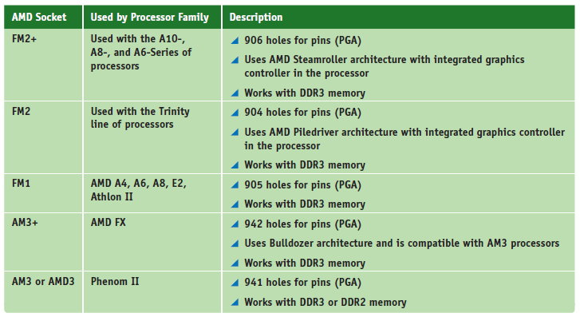
Processor Sockets
Table 3-3 Sockets for AMD processors used for desktop computers
Notes:
Processor Sockets

Slide 14
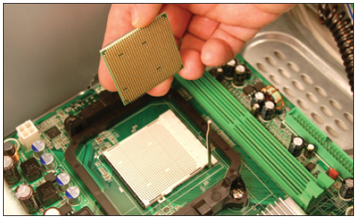
Processor Sockets
Match a processor to the socket and motherboard
Refer to motherboard, processor compatibility documentation
Figure 3-10 AMD Athlon 64 processor to be inserted into an AM2+ socket
Notes:
Processor Sockets
Match a processor to the socket and motherboard
Refer to motherboard, processor compatibility documentation

Slide 15
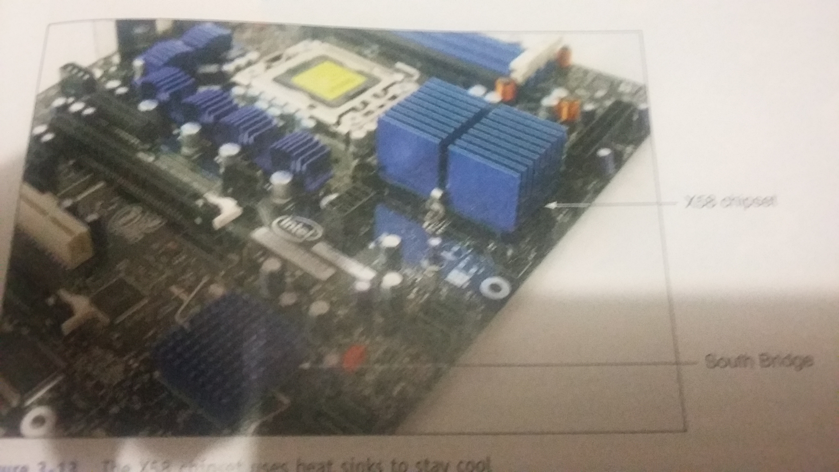
The Chipset
Chipset: set of chips on motherboard that work with processor to collectively control:
Memory, motherboard buses, some peripherals
Major manufacturers
Intel and AMD
Intel Chipsets(N/S bridge, Nehalem, Sandy bridge, Ivy bridge, Haswell and Broadwell, …)
North Bridge and South Bridge - Uses hub interface
All I/O buses (input/output buses) connect to hub
Hub connects to system bus
North Bridge – fast end of hub
South Bridge – slow end of hub
Notes:
The Chipset
Chipset: set of chips on motherboard that work with processor to collectively control:
Memory, motherboard buses, some peripherals
Major manufacturers
Intel and AMD
Intel Chipsets
North Bridge and South Bridge - Uses hub interface
All I/O buses (input/output buses) connect to hub
Hub connects to system bus
North Bridge – fast end of hub
South Bridge – slow end of hub

Slide 16
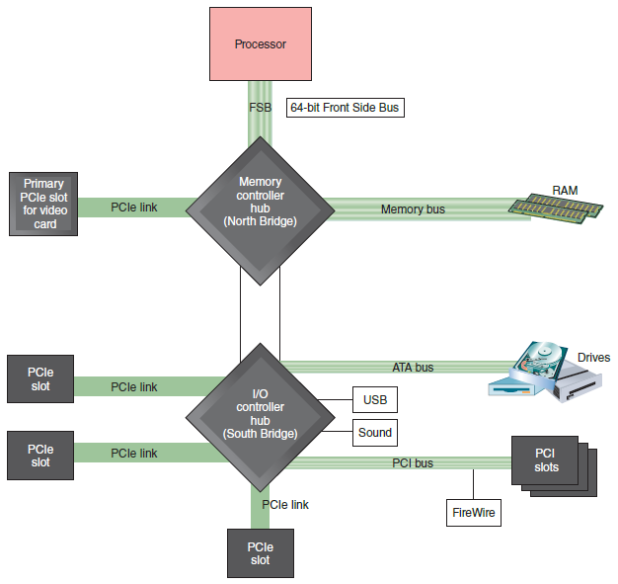
The Chipset
Figure 3-11 The chipset’s North Bridge and South Bridge control access to the
processor for all components
Notes:
The Chipset

Slide 17
The Chipset
Intel Chipsets (cont’d)
Nehalem chipset
Contain memory controller within processor housing
Memory connects directly to processor
Has QuickPath Interconnect (QPI) technology
Has 16 lanes for data packets
Sandy Bridge chipset
Memory and graphics controller in processor
Second Generation Core i7 processor is an example
Sandy Bridge motherboards use DDR3 memory
Notes:
The Chipset
Intel Chipsets (cont’d)
Nehalem chipset
Contain memory controller within processor housing
Memory connects directly to processor
Has QuickPath Interconnect (QPI) technology
Has 16 lanes for data packets
Sandy Bridge chipset
Memory and graphics controller in processor
Second Generation Core i7 processor is an example
Sandy Bridge motherboards use DDR3 memory

Slide 18
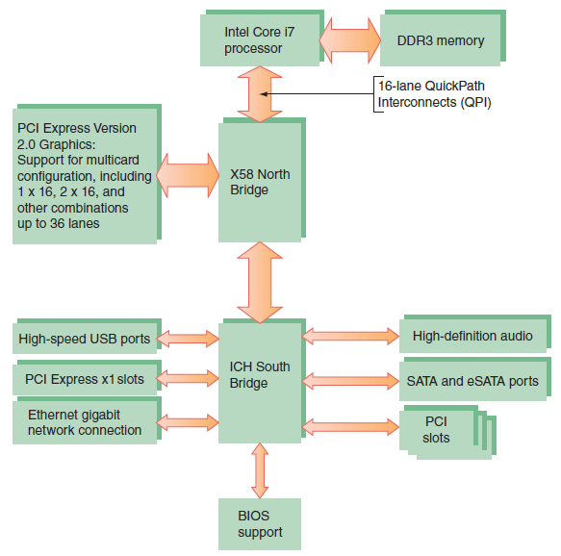
The Chipset
Figure 3-12 X58 chipset architecture
Notes:
The Chipset
Intel Chipsets (cont’d)
Nehalem chipset
Contain memory controller within processor housing
Memory connects directly to processor
Has QuickPath Interconnect (QPI) technology
Has 16 lanes for data packets
Sandy Bridge chipset
Memory and graphics controller in processor
Second Generation Core i7 processor is an example
Sandy Bridge motherboards use DDR3 memory

Slide 19
The Chipset
Intel Chipsets (cont’d)
Ivy Bridge chipset – 3rd generation processors released in 2012
Use less power
More transistors in a smaller place
Perform better than earlier products
Uses a single Platform Controller Hub
Notes:
The Chipset
Intel Chipsets (cont’d)
Ivy Bridge chipset – 3rd generation processors released in 2012
Use less power
More transistors in a smaller place
Perform better than earlier products
Uses a single Platform Controller Hub

Slide 20
The Chipset
Intel Chipsets (cont’d)
Haswell and Broadwell chipsets
Haswell - released in 2013
Work with the LGA1150 and LGA2011 sockets
Work with DDR3 and DDR4 memory and use less power than previous chipsets
Broadwell – released in 2015
Faster than the Haswell chipsets
Use the LGA1150 socket
Notes:
The Chipset
Intel Chipsets (cont’d)
Haswell and Broadwell chipsets
Haswell - released in 2013
Work with the LGA1150 and LGA2011 sockets
Work with DDR3 and DDR4 memory and use less power than previous chipsets
Broadwell – released in 2015
Faster than the Haswell chipsets
Use the LGA1150 socket

Slide 21
The Chipset
AMD chipsets
AMD A-series
Designed to support the AMD Accelerated Processing Unit (APU), which is a combination of a CPU and a graphics processing unit (GPU)
Support AMD CrossFire technology, which uses dual video cards in the same system
AMD 9-series
Designed to support AMD processors that can have up to eight cores
Notes:
The Chipset
AMD chipsets
AMD A-series
Designed to support the AMD Accelerated Processing Unit (APU), which is a combination of a CPU and a graphics processing unit (GPU)
Support AMD CrossFire technology, which uses dual video cards in the same system
AMD 9-series
Designed to support AMD processors that can have up to eight cores

Slide 22
Buses and Expansion Slots
Bus
System of pathways used for communication
Carried by bus:
Power, control signals, memory addresses, data
These lines are sometimes called data bus
Data and instructions exist in binary
Only two states: on and off
Data path size: width of a data bus
Examples: 8-bit bus has eight wire (lines) to transmit
Notes:
Buses and Expansion Slots
Bus
System of pathways used for communication
Carried by bus:
Power, control signals, memory addresses, data
These lines are sometimes called data bus
Data and instructions exist in binary
Only two states: on and off
Data path size: width of a data bus
Examples: 8-bit bus has eight wire (lines) to transmit

Slide 23
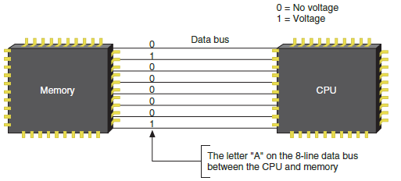
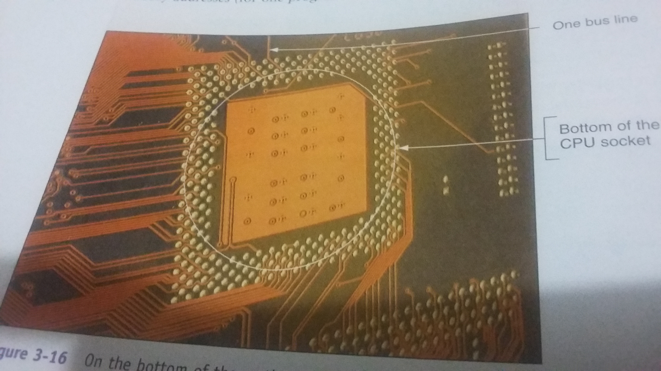
Buses and Expansion Slots
Figure 3-17 A data bus has traces or lines that carry voltage interpreted
by the CPU and other devices as bits
Notes:
Buses and Expansion Slots

Slide 24
Buses and Expansion Slots
System clock (system timer) – times activities on the motherboard
Speed of memory, Front Side Bus, processor, or other component is measured in hertz (Hz), which is one cycle per second
Megahertz (MHz): one million cycles per second
Gigahertz (GHz): one billion cycles per second
Motherboards can have more than one bus
Table 3-4 on the following slide lists many buses
Notes:
Buses and Expansion Slots
System clock (system timer) – times activities on the motherboard
Speed of memory, Front Side Bus, processor, or other component is measured in hertz (Hz), which is one cycle per second
Megahertz (MHz): one million cycles per second
Gigahertz (GHz): one billion cycles per second
Motherboards can have more than one bus
Table 3-4 on the following slide lists many buses

Slide 25
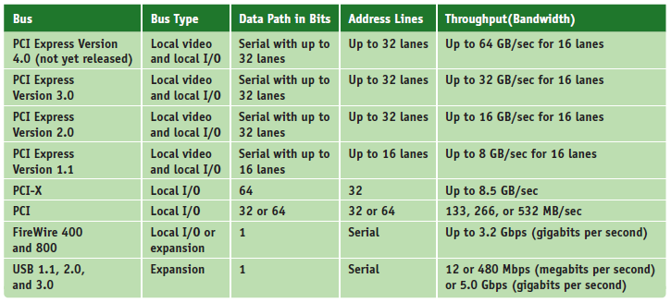
Buses and Expansion Slots
Table 3-4 Buses listed by throughput
Notes:
Buses and Expansion Slots

Slide 26
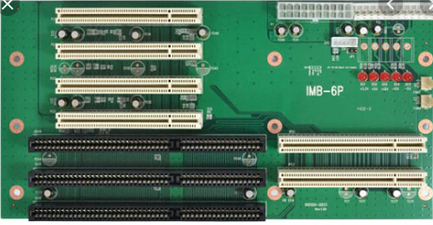
Buses and Expansion Slots
Conventional PCI(Peripheral Component Interconnect, a local bus standard developed by Intel Corporation. Most modern PCs include a PCI bus in addition to a more general ISA expansion bus).
Improved several times
PCI Version 2.x introduced the 64-bit, 3.3 V PCI slot, doubling the data throughput of the bus
Four types of slots and six possible
PCI card configurations
Notes:
Buses and Expansion Slots
Conventional PCI
Improved several times
PCI Version 2.x introduced the 64-bit, 3.3 V PCI slot, doubling the data throughput of the bus
Four types of slots and six possible PCI card configurations

Slide 27
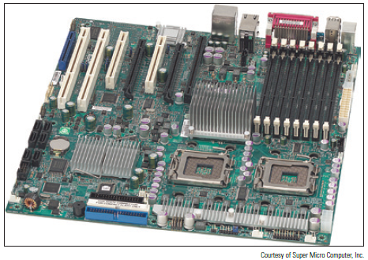
Buses and Expansion Slots
PCI-X
Uses 64-bit data path
Latest revision is PCI-X 3.0 (all revisions are backward-compatible)
Figure 3-20 The two long white
PCI-X slots can support PCI cards
Notes:
Buses and Expansion Slots
PCI-X
Uses 64-bit data path
Latest revision is PCI-X 3.0 (all revisions are backward-compatible)

Slide 28
Buses and Expansion Slots
PCI Express (PCIe)
Not backward compatible with conventional PCI or PCI-X
Expected to replace both PCI and PCI-X
Uses a serial bus, which is faster than parallel
Comes in four different slot sizes
PCI Express x1, x4, x8, and x16
Latest version is PCIe 4.0 which doubles the throughput of version 3.0
Notes:
Buses and Expansion Slots
PCI Express (PCIe)
Not backward compatible with conventional PCI or PCI-X
Expected to replace both PCI and PCI-X
Uses a serial bus, which is faster than parallel
Comes in four different slot sizes
PCI Express x1, x4, x8, and x16
Latest version is PCIe 4.0 which doubles the throughput of version 3.0

Slide 29
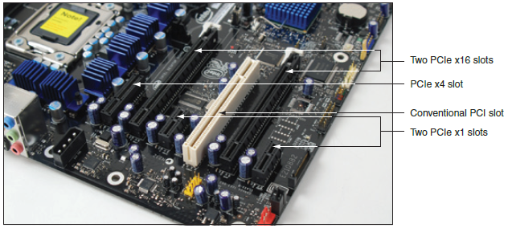
Buses and Expansion Slots
Figure 3-21 Three types of PCIe slots and one conventional PCI slot
Notes:
Buses and Expansion Slots

Slide 30
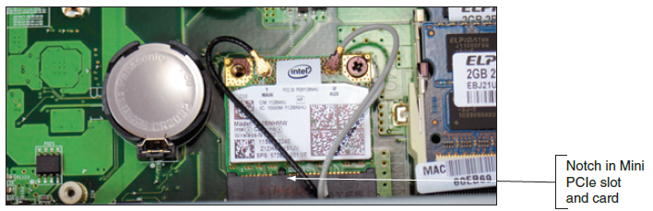
Buses and Expansion Slots
MiniPCi and MiniPCIe in Laptops
Smaller versions of the PCI and PCIe slots
Mini PCIe slots have 52 or 54 pins and one notch offset from the center of the slot
Mini PCI slot is wider with 100 or 124 pins
Figure 3-23 Mini PCIe slot with a wireless Mini PCIe card installed
Notes:
Buses and Expansion Slots
MiniPCi and MiniPCIe in Laptops
Smaller versions of the PCI and PCIe slots
Mini PCIe slots have 52 or 54 pins and one notch offset from the center of the slot
Mini PCI slot is wider with 100 or 124 pins

Slide 31
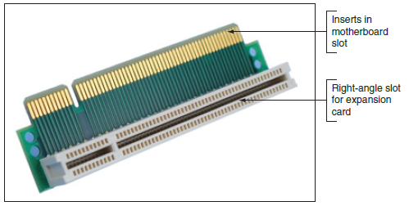
Buses and Expansion Slots
PCI Riser cards
Installs in a PCI slot and provides another slot at a right angle
Used to fit PCI, PCIe, and PCI-X cards into a low-profile or slimline case
Figure 3-25 PCI riser card provides a 3.3-V slot or 5-V slot depending on which direction the card is inserted in the PCI slot
Notes:
Buses and Expansion Slots
PCI Riser cards
Installs in a PCI slot and provides another slot at a right angle
Used to fit PCI, PCIe, and PCI-X cards into a low-profile or slimline case

Slide 32
Onboard Ports and Connectors
Onboard ports (integrated components)
Ports coming directly off the motherboard
USB, sound, network, FireWire, video, eSATA ports
Older motherboards might have mouse and keyboard ports, parallel and serial ports
I/O shield
Plate installed in computer case providing holes for on-board ports
Internal connectors
SATA, USB or FireWire (IEEE 1394) connectors
Notes:
Onboard Ports and Connectors
Onboard ports (integrated components)
Ports coming directly off the motherboard
USB, sound, network, FireWire, video, eSATA ports
Older motherboards might have mouse and keyboard ports, parallel and serial ports
I/O shield
Plate installed in computer case providing holes for on-board ports
Internal connectors
SATA, USB or FireWire (IEEE 1394) connectors

Slide 33
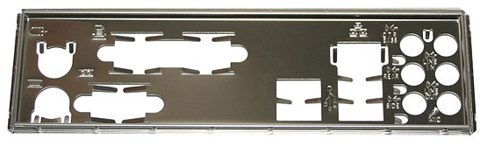
Onboard Ports and Connectors
Notes:
Onboard Ports and Connectors
Onboard ports (integrated components)
Ports coming directly off the motherboard
USB, sound, network, FireWire, video, eSATA ports
Older motherboards might have mouse and keyboard ports, parallel and serial ports
I/O shield
Plate installed in computer case providing holes for on-board ports
Internal connectors
SATA, USB or FireWire (IEEE 1394) connectors

Slide 34
Configuring a Motherboard
Firmware is used to configure a motherboard
Motherboard settings
Enable or disable connector or port
Set CPU frequency, system bus, other buses
Control security features
Control what happens when PC first boots
Motherboards may use these types of firmware:
BIOS – used on older motherboards
UEFI – replacing BIOS
UEFI with BIOS – for backward compatibility
Notes:
Configuring a Motherboard
Motherboard settings
Enable or disable connector or port
Set CPU frequency, system bus, other buses
Control security features
Control what happens when PC first boots
Motherboards may use these types of firmware:
BIOS – used on older motherboards
UEFI – replacing BIOS
UEFI with BIOS – for backward compatibility

Slide 35
Using BIOS Setup To Configure a Motherboard
Access the BIOS Setup Program
Press a key or combination of keys during the boot process
Varies from one manufacturer to another
See documentation for your motherboard or watch the screen near the beginning of the boot
Setup screen appears with menus and Help features
Notes:
Using BIOS Setup To Configure a Motherboard
Access the BIOS Setup Program
Press a key or combination of keys during the boot process
Varies from one manufacturer to another
See documentation for your motherboard or watch the screen near the beginning of the boot
Setup screen appears with menus and Help features

Slide 36
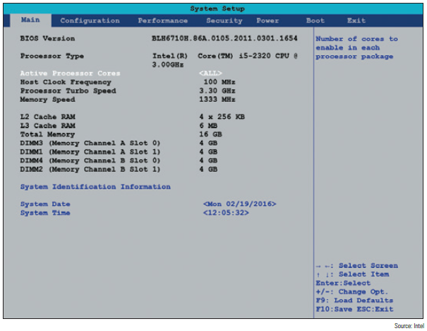
Using BIOS Setup To Configure a Motherboard
Figure 3-31 BIOS setup main menu
Notes:
Using BIOS Setup To Configure a Motherboard

Slide 37
Using Setup BIOS To Configure a Motherboard
Change the boot sequence
Might need to change boot sequence from hard drive to DVD for a new Windows install
After the OS is installed, change setup BIOS to boot first from the hard drive
To prevent accidental boots from a DVD or other media
If troubleshooting a boot problem, be sure to set BIOS to perform a full POST
Notes:
Using Setup BIOS To Configure a Motherboard
Change the boot sequence
Might need to change boot sequence from hard drive to DVD for a new Windows install
After the OS is installed, change setup BIOS to boot first from the hard drive
To prevent accidental boots from a DVD or other media
If troubleshooting a boot problem, be sure to set BIOS to perform a full POST

Slide 38
Using Setup BIOS To Configure a Motherboard
Configure onboard devices
Enable/disable a port or group of ports
View hard drive and optical drive information
Processor and clock speeds
Some motherboards allow changing the processor speed and/or the memory multiplier (overclocking)
Monitor temperatures, fan speeds, and voltages
Intrusion detection
Can enable event logging (logs when case is opened)
Notes:
Using Setup BIOS To Configure a Motherboard
Configure onboard devices
Enable/disable a port or group of ports
View hard drive and optical drive information
Processor and clock speeds
Some motherboards allow changing the processor speed and/or the memory multiplier (overclocking)
Monitor temperatures, fan speeds, and voltages
Intrusion detection
Can enable event logging (logs when case is opened)

Slide 39
Using Setup BIOS To Configure a Motherboard
Power-on passwords
Assigned in BIOS setup to prevent unauthorized access to the computer and/or BIOS setup utility
May be possible to set a supervisor and user password
If both passwords are set, must enter a valid password to boot the system
How to set passwords varies depending on motherboard and BIOS
Notes:
Using Setup BIOS To Configure a Motherboard
Power-on passwords
Assigned in BIOS setup to prevent unauthorized access to the computer and/or BIOS setup utility
May be possible to set a supervisor and user password
If both passwords are set, must enter a valid password to boot the system
How to set passwords varies depending on motherboard and BIOS

Slide 40
Using Setup BIOS To Configure a Motherboard
BIOS Support for Virtualization
Virtualization is when one physical machine hosts activities that are normally done on multiple machines
Virtual machine (VM) is software that simulates the hardware of a physical computer
Each VM works like a physical computer and is assigned virtual devices such as virtual motherboard and virtual hard drive
Virtualization must be enabled in BIOS setup
Notes:
Using Setup BIOS To Configure a Motherboard
BIOS Support for Virtualization
Virtualization is when one physical machine hosts activities that are normally done on multiple machines
Virtual machine (VM) is software that simulates the hardware of a physical computer
Each VM works like a physical computer and is assigned virtual devices such as virtual motherboard and virtual hard drive
Virtualization must be enabled in BIOS setup

Slide 41
Using Setup BIOS To Configure a Motherboard
LoJack for Laptops Technology
Technology embedded in the BIOS of many laptops to protect a system against theft
Must subscribe to service
Software and BIOS work together to locate a laptop whenever it connects to the Internet
Drive Encryption and Drive Password Protection
Some motherboards allow you to set a password in order to access the hard drive
Password is kept on drive so that it still works even if drive is moved to another computer
Notes:
Using Setup BIOS To Configure a Motherboard
LoJack for Laptops Technology
Technology embedded in the BIOS of many laptops to protect a system against theft
Must subscribe to service
Software and BIOS work together to locate a laptop whenever it connects to the Internet
Drive Encryption and Drive Password Protection
Some motherboards allow you to set a password in order to access the hard drive
Password is kept on drive so that it still works even if drive is moved to another computer

Slide 42
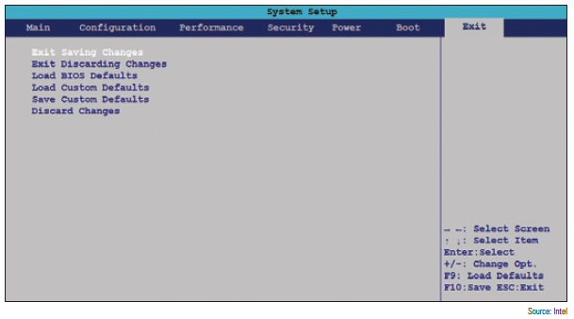
Using Setup BIOS To Configure a Motherboard
Exiting the BIOS setup menus
Most exit screens give several options
Figure 3-40 BIOS setup Exit menu
Notes:
Using Setup BIOS To Configure a Motherboard
Exiting the BIOS setup menus
Most exit screens give several options

Slide 43
Using UEFI Setup to Configure a Motherboard
Extensible Firmware Interface (EFI), original version first developed by Intel
Improves on BIOS in these ways:
Faster and better booting
Mouse-enabled interface
Secure boot
Support for hard drives larger than 2 TB
Provides a BIOS boot through its Compatibility Support Module (CSM)
Notes:
Using UEFI Setup to Configure a Motherboard
Extensible Firmware Interface (EFI), original version first developed by Intel
Improves on BIOS in these ways:
Faster and better booting
Mouse-enabled interface
Secure boot
Support for hard drives larger than 2 TB
Provides a BIOS boot through its Compatibility Support Module (CSM)

Slide 44
Maintaining a Motherboard
Motherboard is considered a field replaceable unit
Need to know how to:
Update motherboard drivers
Flash BIOS or UEFI
Replace CMOS battery
Notes:
Maintaining a Motherboard
Motherboard is considered a field replaceable unit
Need to know how to:
Update motherboard drivers
Update flash BIOS or UEFI
Replace CMOS battery

Slide 45
Updating Motherboard Drivers
Device drivers are small programs that allow software to interact with certain hardware
Use Windows internal drivers, bundled CD drivers, or download drivers from manufacturer site
Always use 32-bit drivers with a 32-bit OS and 64-bit drivers with a 64-bit OS
Notes:
Updating Motherboard Drivers
Device drivers are small programs that allow software to interact with certain hardware
Use Windows internal drivers, bundled CD drivers, or download drivers from manufacturer site
Always use 32-bit drivers with a 32-bit OS and 64-bit drivers with a 64-bit OS

Slide 46
Flashing BIOS
Flashing BIOS is the process of upgrading or refreshing the programming stored on the firmware chip
BIOS updates are downloaded from motherboard manufacturer’s Web site or third party site
Performed if:
System hangs at odd times or during boot
Motherboard becomes unstable
Incorporating new feature, or component
Notes:
Flashing BIOS
Flashing BIOS is the process of upgrading or refreshing the programming stored on the firmware chip
BIOS updates are downloaded from motherboard manufacturer’s Web site or third party site
Performed if:
System hangs at odd times or during boot
Motherboard becomes unstable
Incorporating new feature, or component

Slide 47
Flashing BIOS
Methods of installing BIOS updates
Express BIOS update
Update from a USB flash drive using setup BIOS
Update using a bootable CD
Recovery from a failed update
“If it’s not broke, don’t fix it” – only update if you’re having trouble with a motherboard
Don’t update unless the update is a later version than the one installed
Update should not be interrupted while in progress
Notes:
Flashing BIOS
Methods of installing BIOS updates
Express BIOS update
Update from a USB flash drive using setup BIOS
Update using a bootable CD
Recovery from a failed update
“If it’s not broke, don’t fix it” – only update if you’re having trouble with a motherboard
Don’t update unless the update is a later version than the one installed
Update should not be interrupted while in progress

Slide 48
Flashing UEFI
UEFI updates are more secure than BIOS updates
Require digital signatures for update to be verified
UEFI firmware, drivers, and databases can be updated by way of a USB flash drive or from within Windows
Windows updates sometimes include UEFI updates
When Windows receives a UEFI update, it hands off the update to UEFI
Firmware is responsible for applying the update and displays a screen letting user know not to disturb the system while the update is in progress
Notes:
Flashing UEFI
UEFI updates are more secure than BIOS updates
Require digital signatures for update to be verified
UEFI firmware, drivers, and databases can be updated by way of a USB flash drive or from within Windows
Windows updates sometimes include UEFI updates
When Windows receives a UEFI update, it hands off the update to UEFI
Firmware is responsible for applying the update and displays a screen letting user know not to disturb the system while the update is in progress

Slide 49
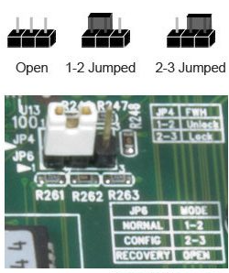
Using Jumpers to Clear BIOS Settings
Jumper – two small posts or metal pins that stick up off the motherboard that is open or closed
Open jumper has no cover and a closed jumper has a cover on the two pins
Jumpers can be used to clear a forgotten supervisor or power-on password
If flashing BIOS fails, a jumper can
be set to undo the update
Notes:
Using Jumpers to Clear BIOS Settings
Jumper – two small posts or metal pins that stick up off the motherboard that is open or closed
Open jumper has no cover and a closed jumper has a cover on the two pins
Jumpers can be used to clear a forgotten supervisor or power-on password
If flashing BIOS fails, a jumper can be set to undo the update

Slide 50
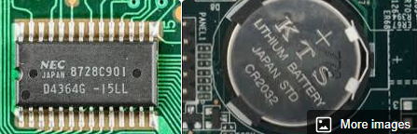
Replacing the CMOS Battery
CMOS (complementary metal-oxide semiconductor) RAM is a small amount of memory stored on the motherboard that retains data
Even when computer is turned off
If the CMOS battery is disconnected or fails, setup information is lost
Notes:
Replacing the CMOS Battery
CMOS (complementary metal-oxide semiconductor) RAM is a small amount of memory stored on the motherboard that retains data
Even when computer is turned off
If the CMOS battery is disconnected or fails, setup information is lost
To replace the CMOS battery:
Choose correct replacement battery
Power down system, unplug it, press power button to drain the power, remove case cover
Use ESD strap, remove old battery using a flat-head screwdriver, pop new battery into place

Slide 51
Replacing the CMOS Battery
To replace the CMOS battery:
Choose correct replacement battery
Power down system, unplug it, press power button to drain the power, remove case cover
Use ESD strap, remove old battery using a flat-head screwdriver, pop new battery into place
Notes:
Replacing the CMOS Battery
CMOS (complementary metal-oxide semiconductor) RAM is a small amount of memory stored on the motherboard that retains data
Even when computer is turned off
If the CMOS battery is disconnected or fails, setup information is lost
To replace the CMOS battery:
Choose correct replacement battery
Power down system, unplug it, press power button to drain the power, remove case cover
Use ESD strap, remove old battery using a flat-head screwdriver, pop new battery into place

Slide 52
Installing or Replacing a Motherboard
A motherboard is considered a field replaceable unit
A technician needs to know how to:
Select an appropriate motherboard
Install or replace one in a desktop or laptop computer
Notes:
Installing or Replacing a Motherboard
A motherboard is considered a field replaceable unit
A technician needs to know how to:
Select an appropriate motherboard
Install or replace one in a desktop or laptop computer

Slide 53
How to Select a Desktop Motherboard
Three approaches to selecting a motherboard:
Select the board that provides the most room for expansion, so you can upgrade and exchange components and add devices easily
Select the board that best suits the needs of the computer’s current configuration
Select a motherboard that meets your present needs with moderate room for expansion
Notes:
How to Select a Desktop Motherboard
Three approaches to selecting a motherboard:
Select the board that provides the most room for expansion, so you can upgrade and exchange components and add devices easily
Select the board that best suits the needs of the computer’s current configuration
Select a motherboard that meets your present needs with moderate room for expansion

Slide 54
How to Select a Desktop Motherboard
Consider the following when selecting a motherboard:
Form factor
The brand (Intel or AMD) and model processors the board supports
Chipset and memory speeds the board supports
Expansion slots (type and how many needed)
Hard drive controllers
Case
Price and warranty
Support
Notes:
How to Select a Desktop Motherboard
Consider the following when selecting a motherboard:
Form factor
The brand (Intel or AMD) and model processors the board supports
Chipset and memory speeds the board supports
Expansion slots (type and how many needed)
Hard drive controllers
Case
Price and warranty
Support

Slide 55
How to Install or Replace a Motherboard
General process for replacing a motherboard:
1. Verify right motherboard is selected
2. Get familiar with documentation, features, settings
3. Remove components to reach old motherboard
4. Install the I/O shield (metal plate)
5. Install motherboard
6. Install processor and processor cooler
7. Install RAM
8. Attach cabling (case switches, power supply, drives)
Notes:
How to Install or Replace a Motherboard
General process for replacing a motherboard:
1. Verify right motherboard is selected
2. Get familiar with documentation, features, settings
3. Remove components to reach old motherboard
4. Install the I/O shield (metal plate)
5. Install motherboard
6. Install processor and processor cooler
7. Install RAM
8. Attach cabling (case switches, power supply, drives)

Slide 56
How to Install or Replace a Motherboard
General process for replacing motherboard (cont’d.)
9. Install video card on motherboard
10. Plug in PC, attach monitor, keyboard
11. Boot system, enter UEFI/BIOS setup
12. Observe POST, verify no errors
13. Verify Windows starts with no errors
14. Install the motherboard drivers
15. Install other expansion cards and drivers
16. Verify system operating properly, make final OS and UEFI/BIOS adjustments
setting power-on passwords
Notes:
How to Install or Replace a Motherboard
General process for replacing motherboard (cont’d.)
9. Install video card on motherboard
10. Plug in PC, attach monitor, keyboard
11. Boot system, enter UEFI/BIOS setup
12. Observe POST, verify no errors
13. Verify Windows starts with no errors
14. Install the motherboard drivers
15. Install other expansion cards and drivers
16. Verify system operating properly, make final OS and UEFI/BIOS adjustments
setting power-on passwords

Slide 57
Replacing a Laptop System Board
May need to fully disassemble the entire notebook
Consider alternatives before proceeding
General procedure for replacing the motherboard:
Remove the keyboard, optical drive, and mini PCIe card
Remove the notebook lid and keyboard bezel assembly
Lift up the assembly and disconnect two cables connecting it to the motherboard
Remove CPU and DVD drive
Remove screw that hold motherboard in place
Notes:
Replacing a Laptop System Board
May need to fully disassemble the entire notebook
Consider alternatives before proceeding
General procedure for replacing the motherboard:
Remove the keyboard, optical drive, and mini PCIe card
Remove the notebook lid and keyboard bezel assembly
Lift up the assembly and disconnect two cables connecting it to the motherboard
Remove CPU and DVD drive
Remove screw that hold motherboard in place

Slide 58
Summary
The motherboard is the most complicated of all components inside a computer
Most popular motherboard form factors are ATX, MicroATX and Mini-ITX
Motherboard will have one or more processor sockets
Chipset embedded on the motherboard determines what kind of processor/memory are supported
Major advancements in Intel: Accelerated Hub Architecture, Nehalem chipsets, and Sandy Bridge
Notes:
Summary
The motherboard is the most complicated of all components inside a computer
Most popular motherboard form factors are ATX, MicroATX and Mini-ITX
Motherboard will have one or more processor sockets
Chipset embedded on the motherboard determines what kind of processor/memory are supported
Major advancements in Intel: Accelerated Hub Architecture, Nehalem chipsets, and Sandy Bridge

Slide 59
Summary
Buses include conventional PCI, PIC-X, and PCI Express
Some components can be built into the motherboard, called on-board components
Firmware that controls a motherboard and the boot is the older BIOS and the newer UEFI
Settings that can be changed include: changing boot order, enabling or disabling onboard devices, support for virtualization, and security settings
Notes:
Summary
Buses include conventional PCI, PIC-X, and PCI Express
Some components can be built into the motherboard, called on-board components
Firmware that controls a motherboard and the boot is the older BIOS and the newer UEFI
Settings that can be changed include: changing boot order, enabling or disabling onboard devices, support for virtualization, and security settings

Slide 60
Summary
Motherboard drivers and/or BIOS might need updating to fix a problem
CMOS battery might need replacing
When selecting a motherboard pay attention to the form factor, chipset, expansion slots, memory slots, and processors supported
Study motherboard manual before installing it
For laptops, it’s usually more cost effective to replace the laptop than to replace a failed system board
Notes:
Summary
Motherboard drivers and/or BIOS might need updating to fix a problem
CMOS battery might need replacing
When selecting a motherboard pay attention to the form factor, chipset, expansion slots, memory slots, and processors supported
Study motherboard manual before installing it
For laptops, it’s usually more cost effective to replace the laptop than to replace a failed system board

